Slide 1

INAUDIBLE AUDIO ADVERSARIAL DEFENSE
White-Box Attack Mitigation via Acoustic Firewalls

Slide 2

The Invisible Threat
Modern Automatic Speech Recognition (ASR) systems rely on highly sensitive neural networks that are mathematically vulnerable to stealthy hijacking through inaudible perturbations.

Slide 3


NDSS 2024 THREAT LANDSCAPE
VRIFLE Attack Model
Nonlinear Vulnerability
Inspired by 2024 research, the attack utilizes ultrasonic delivery to inject adversarial perturbations that are entirely inaudible to human users but processed by voice assistants.
Leveraging microphone hardware nonlinearity, high-frequency ultrasonic carriers are demodulated into the baseband, allowing attackers to inject commands in real-time.

Slide 4

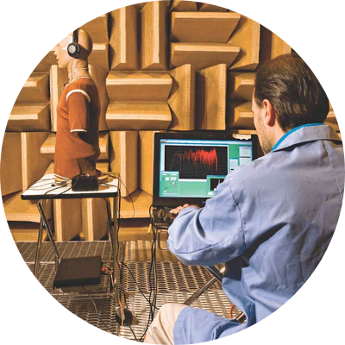
FLUENT SPEECH COMMANDS
The Carrier Payload
We utilize the Fluent Speech Commands dataset as our carrier signal. It contains over 30,000 recordings of smart home commands, providing a diverse baseline for testing hijacking robustness across multiple speakers.

Slide 5

PGD OPTIMIZATION STRATEGY
Projected Gradient Descent (PGD) iteratively updates the audio tensor to minimize loss against a malicious target transcript.

Slide 6
UNMITIGATED HIJACKING SUCCESS
100%
Stealth Payload Execution
Without an active firewall, the system successfully transcribes the malicious command "Unlock front door" across 100% of tested samples from the Fluent Speech Commands dataset.
Attack Success Rate (ASR)

Slide 7
MU-LAW COMPANDING DEFENSE
Logarithmic Protection
By applying Mu-Law Companding, we logarithmically compress the audio signal. This telecommunications technique effectively shatters the fragile, linear adversarial noise calculated by the PGD algorithm.
The macroscopic human voice survives the compression, while the microscopic adversarial gradients are mathematically obliterated.

Slide 8
SYSTEM EVALUATION LIFECYCLE
Phase 1: Baseline
Phase 2: Compromise
Phase 3: Mitigation
Phase 4: Secured
System processes benign audio to establish ground truth transcription.
PGD algorithm injects inaudible noise to hijack the model output.
Mu-Law firewall intercepts and purifies the acoustic signal.
Model rejects malicious command, protecting system integrity.

Slide 9

QUANTITATIVE PERFORMANCE METRICS
Note: Post-Defense Accuracy drop represents the "Accuracy vs. Robustness" trade-off common in adversarial machine learning.

Slide 10
THE SECURITY PARADOX
"
It is infinitely better for an AI to fail-safe and ask 'please repeat that' than to silently execute a hacker's command to unlock the front door.
— Security Methodology Insight

Slide 11


THE PATH FORWARD
Adversarial Training: Fine-tuning ASR models on Mu-Law companded audio to restore lost phonetic accuracy.
Ultrasonic Detection: Implementing hardware-level energy detectors for frequencies >20kHz.
Multi-Model Ensembles: Cross-verifying audio through multiple filters to ensure signal consistency.

Slide 12
Questions?
Inaudible Adversarial Audio Defense & Acoustic Firewalls
Abhi | Information Security Research

Slide 13




IMAGE SOURCES
https://www.datocms-assets.com/53444/1756371572-headphones-testing-anechoic-chamber.jpg?auto=format&w=1200
Source: dewesoft.com
https://www.physicsclassroom.com/Class/sound/u11l1c2.gif
Source: www.physicsclassroom.com
https://cdn.vectorstock.com/i/1000v/04/37/grey-shield-with-teal-waveform-ids-icon-vector-59960437.jpg
Source: www.vectorstock.com
https://img.freepik.com/free-psd/abstract-digital-data-stream-green-binary-code-visualization_632498-26033.jpg
Source: www.freepik.com

